Slide 1
Intro to Automation testing
-sangam thakur

Slide 2
What is automation testing
Automation testing is use of tools and software to perform software testing
Developing and executing tests that can run and compare the actual to expected results
The automation software can also enter test data into the system under test, compare expected and actual results and generate detailed test reports

Slide 3
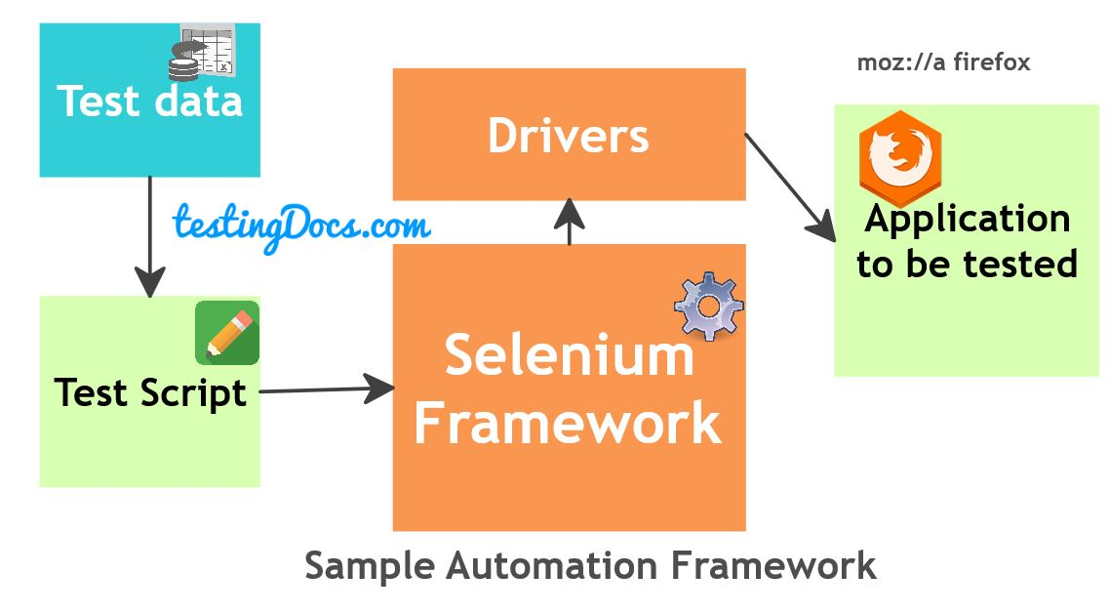

Slide 4
Why to automate
Automation improves accuracy, saves time and increases coverage
To make test execution faster, accurate and improves quality
HOW to AUTOMATE
Tests can be automated using dpecific tools and softwares designed to perform repetative action over application under test

Slide 5
Need to automation testing
Speed: Automation scripts are fast when compared to manual tester’s efforts
Reliable: Tests performs precisely the same operations each time they are run, there by eliminating human error
Repeatable: Tests can be repeater n number of times for execution of the same operation
Coverage: Automated tests increase coverage
Reusable: We can reuse tests on different versions of an application, even if the user interface changes

Slide 6
Advantages of automation testing
Saves time: This created time for the tester to perform exploratory testing, concentrate on areas which cant be automated and concentrate on other tasts
Reusable: The automated tests can be reused on different versions of the software

Slide 7
What is Selenium?
Selenium refers to a suite of tools that are widely used in the testing community when it comes to cross-browser testing. Selenium cannot automate desktop applications; it can only be used in browsers.
It supports a number of browsers (Google Chrome 12+, Internet Explorer 7,8,9,10, Safari 5.1+, Opera 11.5, Firefox 3+) and operating systems (Windows, Mac, Linux/Unix).
Selenium also provides compatibility with different programming languages – C#, Java, JavaScript, Ruby, Python, PHP. Testers can choose which language to design test cases in, thus making Selenium highly favorable for its flexibility.

Slide 8
What is Selenium WebDriver?
Selenium WebDriver is a web framework that permits you to execute cross-browser tests. This tool is used for automating web-based application testing to verify that it performs expectedly.

Slide 9
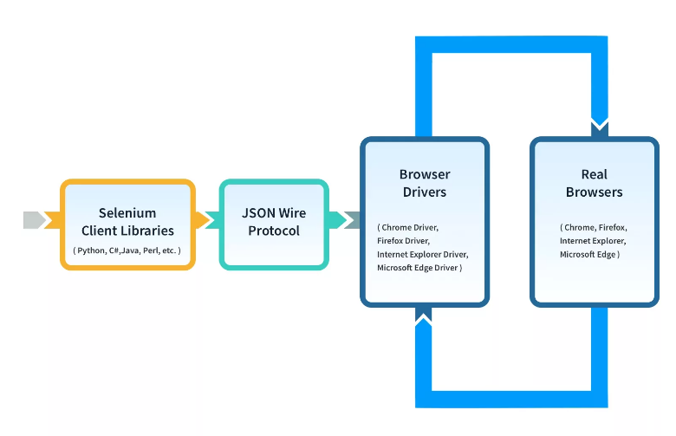

Slide 10
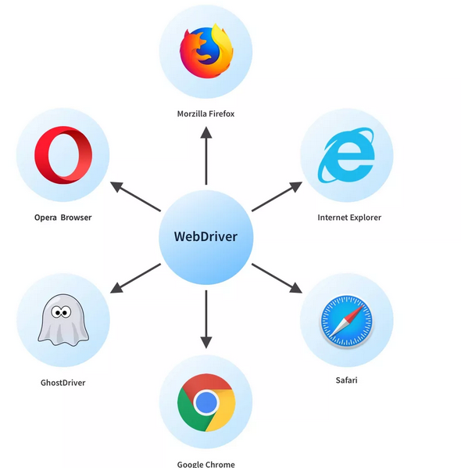
Limitations of WebDriver
Support for new browsers is not readily available
For the automatic generation of test results, it doesn’t have a built-in command

